Slide 1
Timer 3

Slide 2
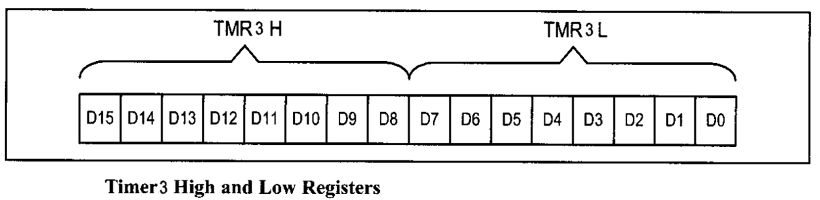

Slide 3
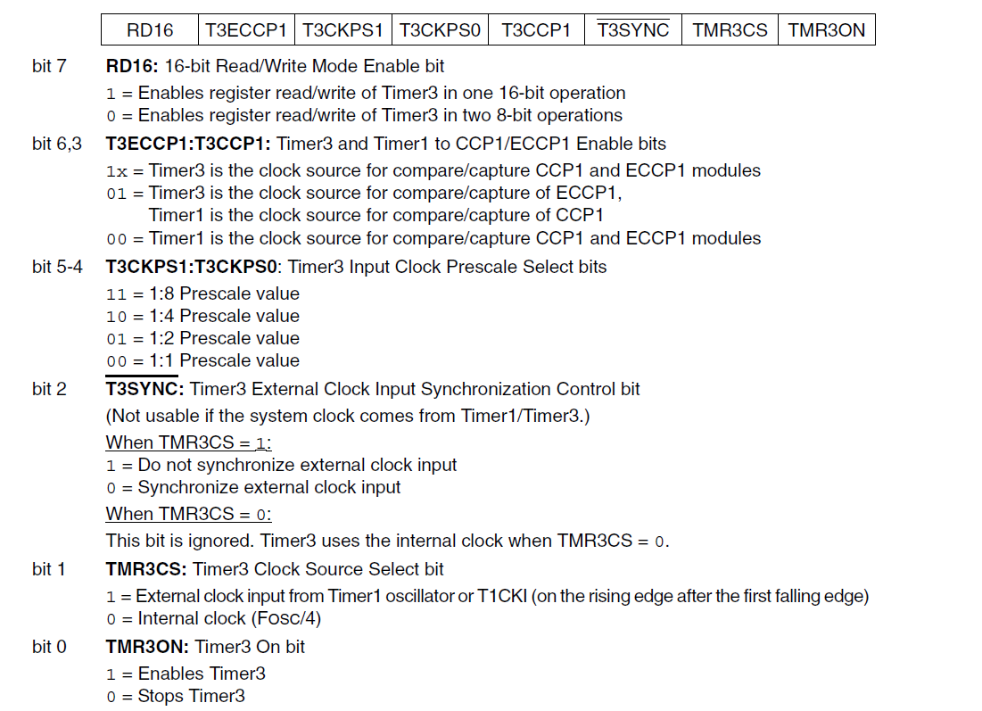
T3CON register

Slide 4
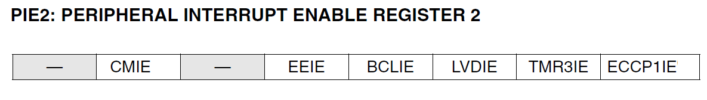
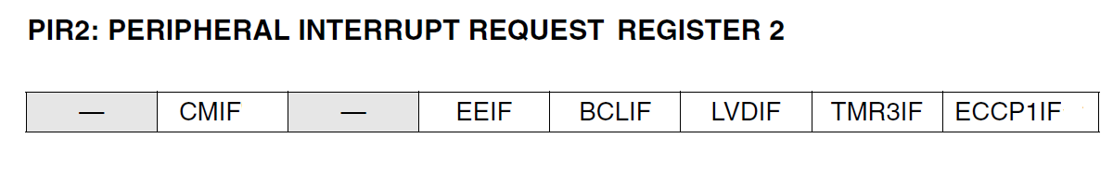

Slide 5
Assuming that XTAL=10MHz, what is the frequency of the square wave at PORTB.5?

Slide 6
BCF TRISB,5
MOVLW 0
MOVWF T3CON
XYZ MOVLW 0X76
MOVWF TMR3H
MOVLW 0X34
MOVWF TMR3L
BCF PIR2, TMR3IF
CALL DLY
BTF PORTB,RB5
BRA XYZ
DLY BSF T3CON, TMR3ON
ABC BTFSS PIR2, TMR3IF
BRA ABC
RETURN
END

Slide 7
BCF TRISB,5
MOVLW 0
MOVWF T3CON
XYZ MOVLW 0X76
MOVWF TMR3H
MOVLW 0X34
MOVWF TMR3L
BCF PIR2, TMR3IF
CALL DLY
BTF PORTB,RB5
BRA XYZ
DLY BSF T3CON, TMR3ON
ABC BTFSS PIR2, TMR3IF
BRA ABC
RETURN
END
➔ T3CON =0 , no prescalar
Microcontroller frequency = 10/4 = 2.5MHz
Clock period = ½.5 =0.4 µs
TMR3H-TMR3L increment count =FFFF-7634+1
=89CCH = 35276 (decimal)
Half cycle delay =35276*0.4 =14.11 ms
Full cycle delay = 28.220 ms
Frequency of square wave = 1/28220.8 = 35.43Hz

Slide 8
A square wave of 50Hz frequency is to be generated on pin PORTB.5, using Timer3 16 bit mode, with maximum prescalar allowed.
Find the values of T3CON, TMR3H and TMR3L registers

Slide 9
T3CON = 30H
f=10/(4*8) = 0.3125 MHz
cycle period = 3.2 µs
Expected Frequency = 50Hz
Full cycle delay = 1/50 = 0.02 s
Half cycle delay (D)= 0.01 s
D=N*3.2 and N=65535-C { C is the value to be stored in timer register}
C=65536-0.01/3.2*1000000 =6241 (decimal) =F3CBH
TMR3H=F3H and TMR3L=CBH

